Slide 1

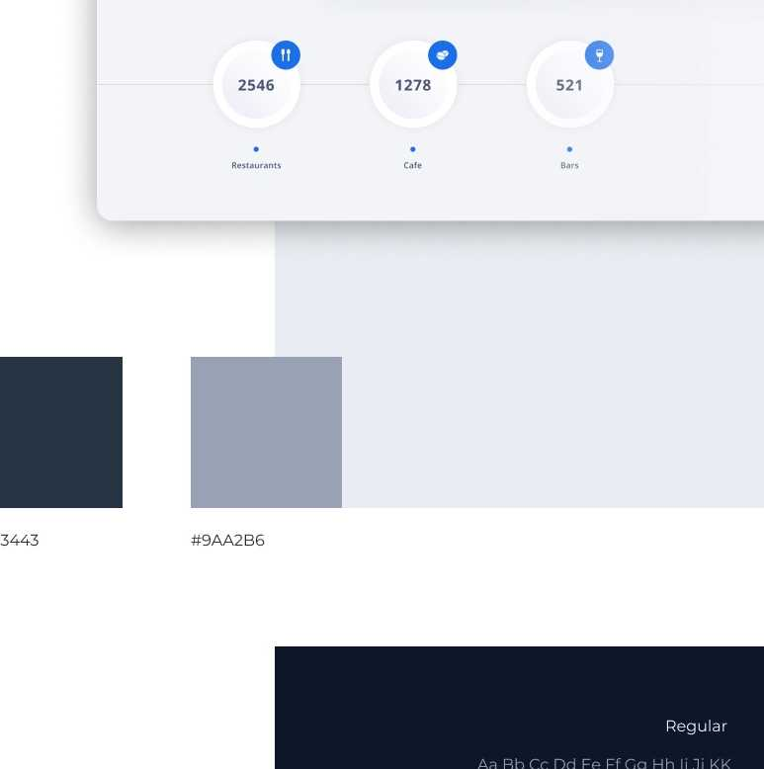
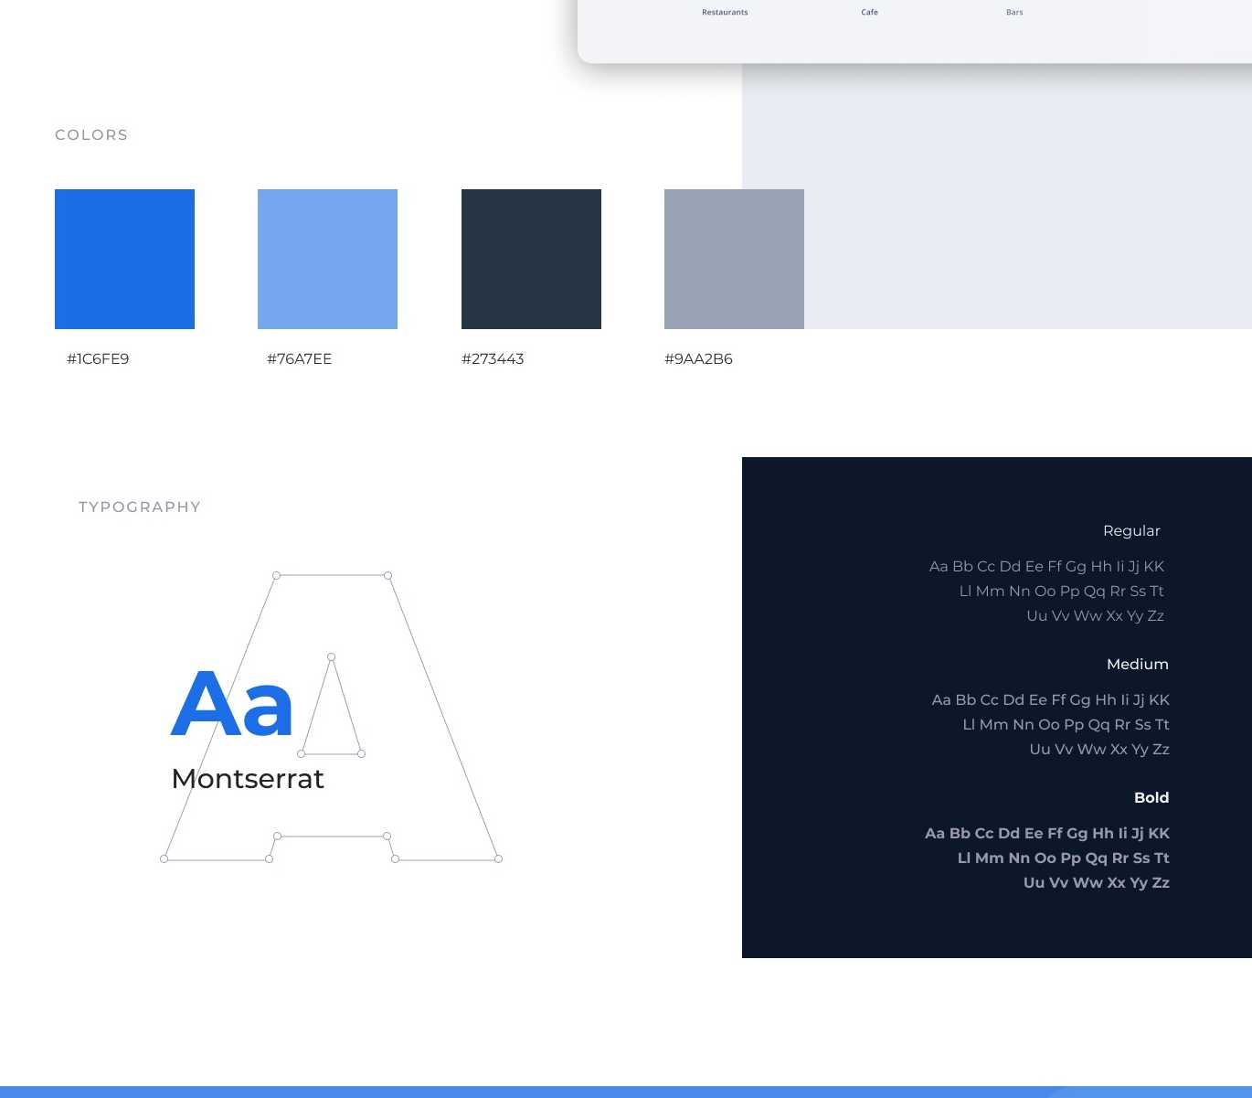
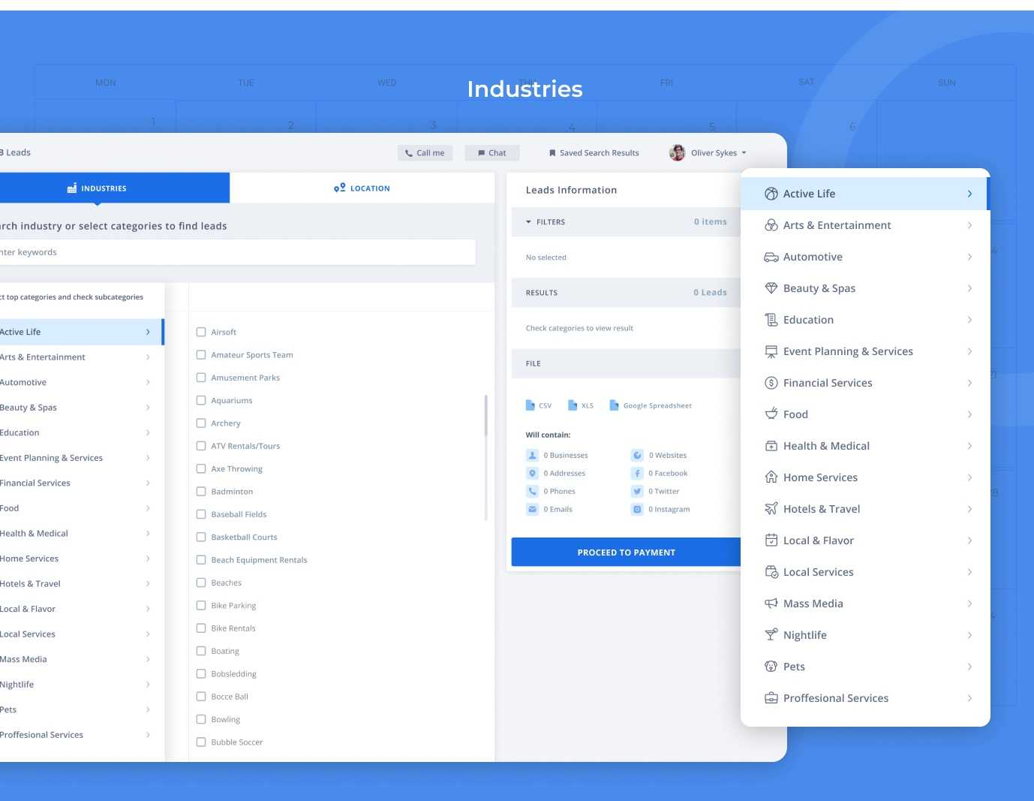
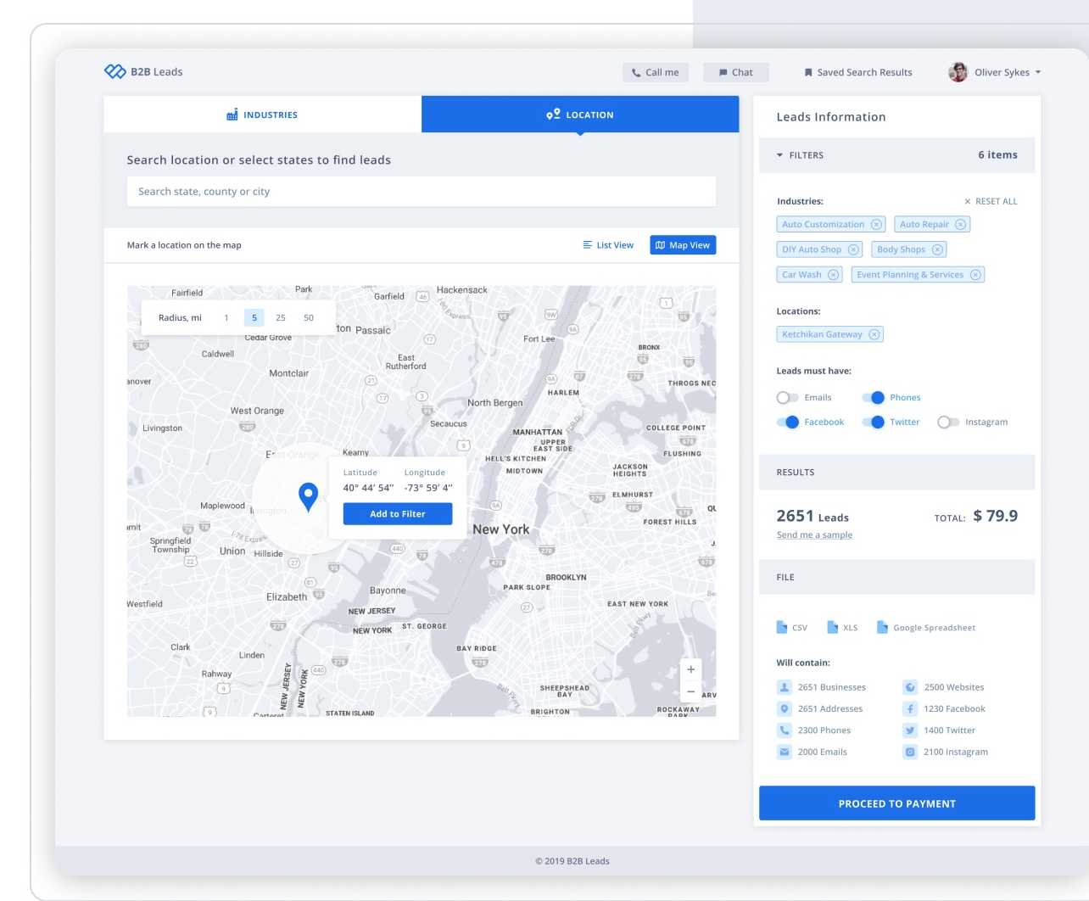


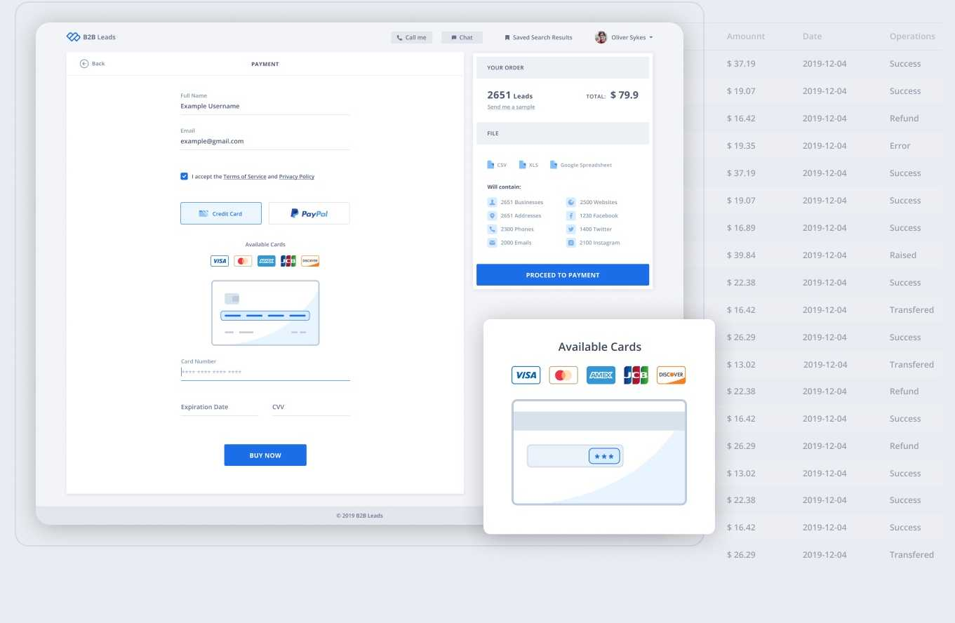


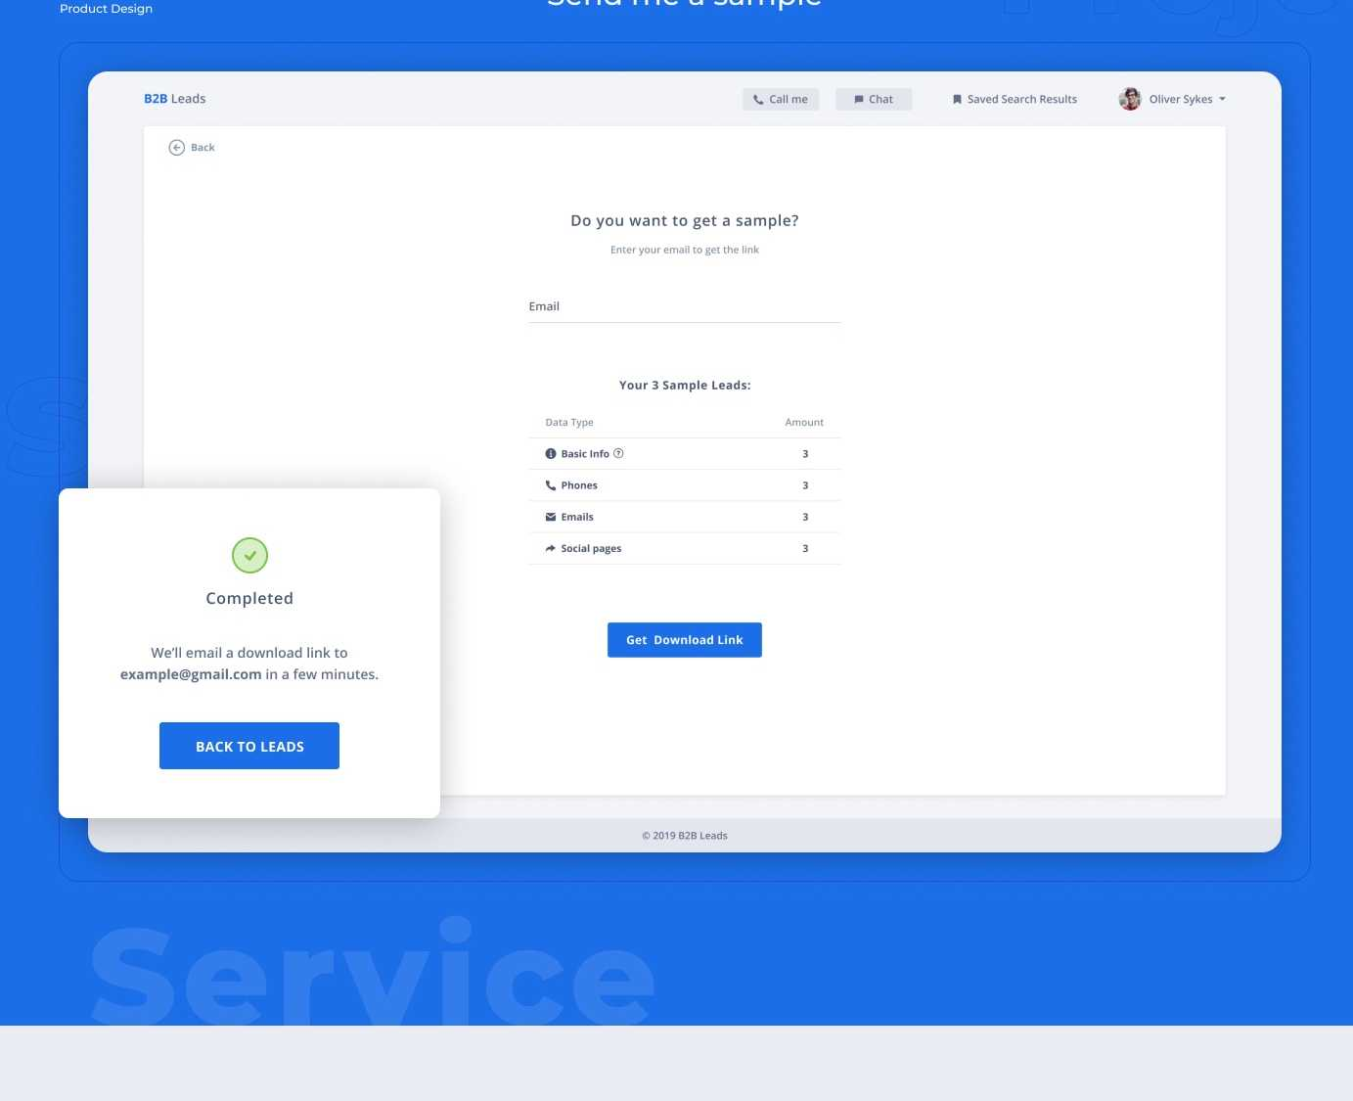
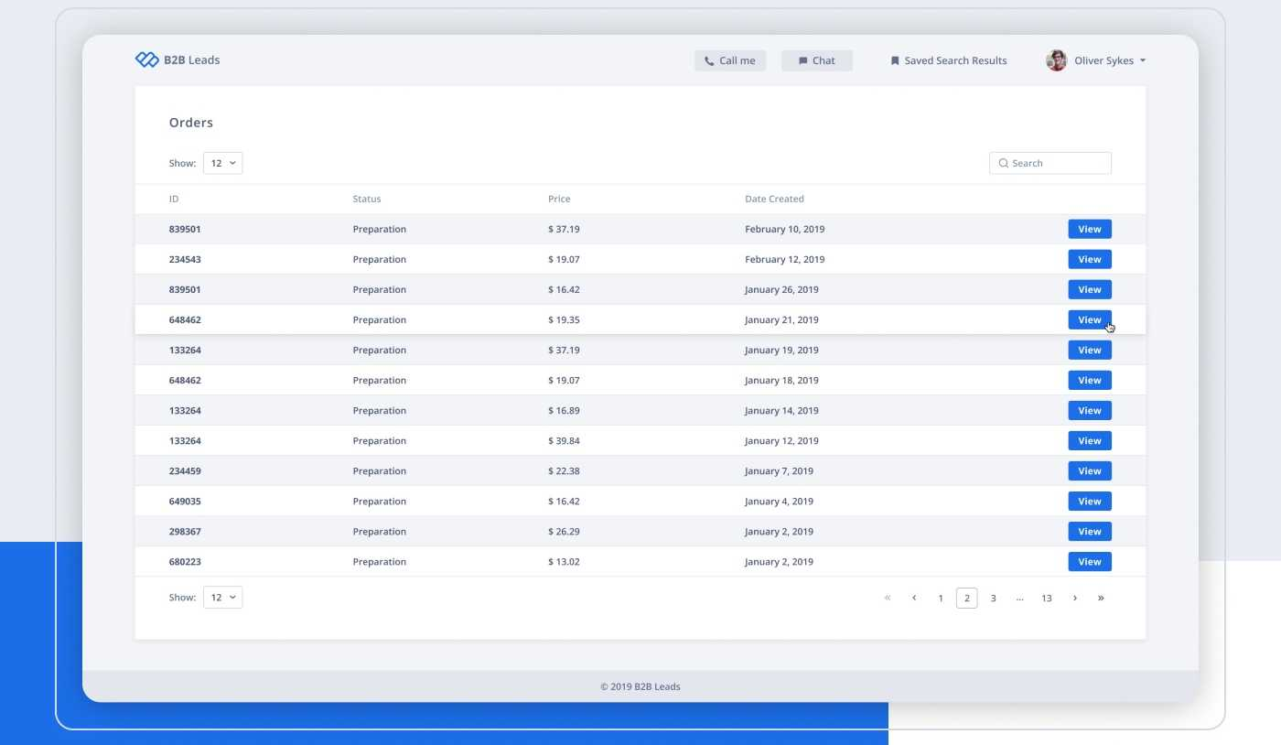


Ul/Ul design
<22>^{B2B} Leads
B2B Leads
B2B Leads is a service for getting leads for business contacts. Users are able to find partners by entering the country, region, and other information.
Locations_map
Payment
д cqmnlp
UI/UX design
Orders
Thanks for watching

